Slide 1
Doing Good Science
MSR DS3 - 2017
Brian Quistorff

Slide 2
Agenda
Prep: get make installed on machines
File Drawer Problem / Publication Bias
Solutions: Pre-registration, Replications, and Meta Analyses
P-hacking
Solutions: Pre-analysis Plans
Reproducible Research

Slide 3
Publication Bias
Journals succeed (money, importance) by publishing statistically significant results
Scientists send in all studies, but only those that are significant are accepted.
Rejected ones go in the file drawer.

Slide 4
File Drawer problem
Scientists think journals are more likely to publish studies with significant results.
Scientists advance in career by publishing.
Submitting studies to a journal is a long and costly process.
Therefore: For studies with null-results, scientists put them directly into the file-drawer.
Self-fulfilling prophecy!

Slide 5
File Drawer / Publication Bias
Could be either due to scientists or journals
In the extreme, it could be that there are no real effects but journals publish the 5% that show effects and the file drawers contain the other 95%!
Studies that have looked at this find there is a real problem but not as bad as the extreme view.

Slide 6
File-Drawer solutions
Find out about the Null Results:
Pre-Registering Clinical Trials before results are known.
Could track down the results even if not published.
At least could know the count of the unpublished studies
Dedicate journals to Null Results
Replicate previous findings.
Dedicate journals for replications.
Helps to detect and prevent fraud.
Meta-analysis

Slide 7
Replication types
Pure: Re-do same analysis with the same data
Statistical: Do same analysis with new data from the same setting
E.g., get a new group of students into a lab experiment
Scientific: Test the same scientific hypothesis (could use slightly different analyses) in a new setting (with new data).

Slide 8
Meta-Analysis
Systematic review of all the studies about a particular effect
Way to summarize and average over several studies.
Can be used to look for publication bias.
Plot each study’s effect against it’s standard error (bigger studies have small standard errors)t

Slide 9
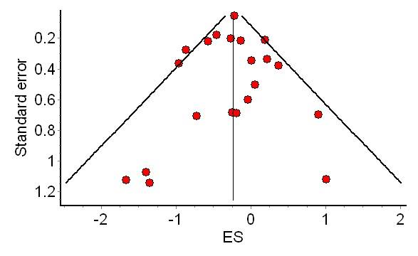
Funnel Plot – No bias

Slide 10
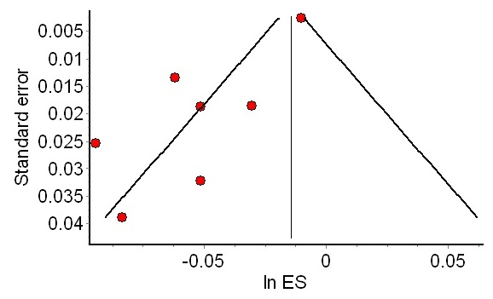
Funnel Plot – Bias?

Slide 11
Types of statistical analyses
There are two types of statistical analyses:
Confirmatory – You decide what to do before see the data
Exploratory – You decide what to do after see the data
P-values are only accurate for confirmatory analyses.
Exploratory analyses are “post hoc” analyses or “testing hypotheses suggested by the data”

Slide 12
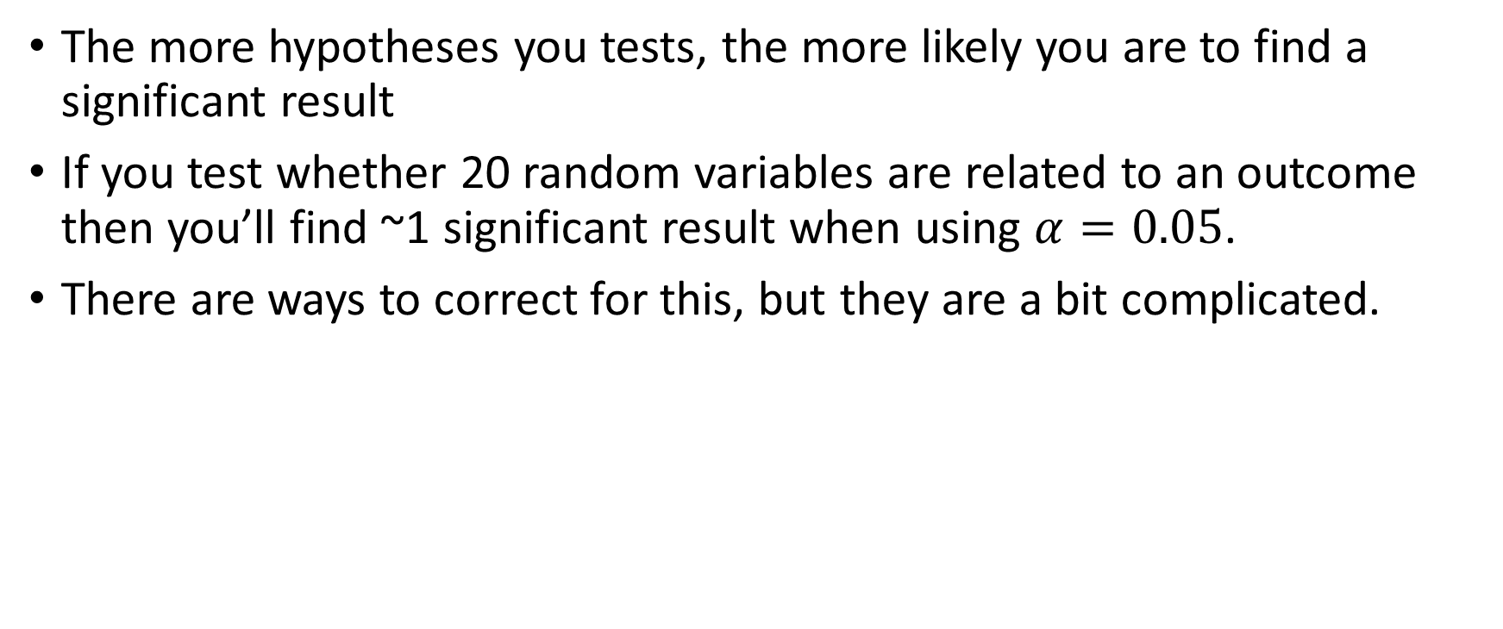
Multiple Hypothesis testing
The more hypotheses you tests, the more likely you are to find a significant result
If you test whether 20 random variables are related to an outcome then you’ll find ~1 significant result when using $α=0.05$.
There are ways to correct for this, but they are a bit complicated.

Slide 13
P-Hacking/Researcher Degrees of Freedom
There are lots of different ways one might want to analyze the data
Researchers may:
Look at the data before deciding what to do
Run many analyses and only report the significant finding
In this case the p-values are not valid any more.
Hard to know if either happened since many legitimate ways to look at data.

Slide 17
Pre-Analysis Plan
When you register your study, before you see the data, say exactly what you are going to do.
Specify all the estimations you will do.
You can always run more estimations as you see fit, but you should mark those are “exploratory” (rather than “confirmatory”) analyses.

Slide 18
Reproducible Research
Goals:
Someone should be able to get the raw data and conduct a pure replication of your study.
If someone has a potential concern about your study they should be able to answer it themselves.
Someone should be able to see if your study is informative for a separate decision
Simple Rule: Everything should be written down.

Slide 19
Reproducible research
All data actions should be automated in code
Nothing just done in the interpreter or GUI. Don’t edit data by hand.
A single command should generate all the results
If using randomness, set the seed.
Code should be able to be run on a different machine
Use relative paths, describe dependencies
Documentation
Code is read about 7x more often than it is written. You should write your code for someone (possibly later you) that knows less
Data: What is interpretation of certain coefficients? What was the control?

Slide 20
Transportable research
Explain the research design.
What were the experimental protocols?
How was the data collected?
Give enough information so that someone somewhere else could:
Have a sense of whether your findings will apply to them
Replicate your study in a new settings (scientific replication)

Slide 21
Tools for Reproducibility
Git (don’t use Dropbox/OneDrive for code!)
Build automation (e.g. Make)
Publish code and data, not just the writeup
GitHub for code
Separate out useful tools to be re-used.
Open Science Framework for projects
Dataverse for data
Pre-print servers (e.g. arXiv, SSRN) for work papers

Slide 22
Build automation
Want to automate the whole workflow (nothing manual):
Cleaning data
Analyzing data
Generating figures, statistics, and tables
Rendering the paper
Saves you time
Reduces errors
We’ll use make

Slide 23
Make
Make is a tool for specifying recipes, usually of how files are produced from others. E.g.
outputs.RData: analysis.R
Rscript analysis.R
Says outputs.Rdata depends on analysis.R and how to remake
If either of those files is newer (modification date) than outputs.Rdata (or outputs.Rdata doesn’t exist), execute the steps below.

Slide 24
Make
Invoke make with a target and it will try to build that.
Creates a Directed Acyclic Graph (DAG) of dependencies and if an ancestor is updated, make can re-make all the intermediaries.
Language agnostic
Recipe indentation has to be tabs!
The first rule is the default (what happens if you just type make). Have this be smart.
Provide some text of what good options are or list all the targets.

Slide 25
Make walk-through
Look through makefile

Slide 26
Make Resources
http://zmjones.com/make/
http://blog.kaggle.com/2012/10/15/make-for-data-scientists/
https://bost.ocks.org/mike/make/

